Slide 1

North Western University, Khulna
Welcome To Our Presentation On computer network using NS2 based on the domain as www.wikipedia.org
Course Tittle: Computer Networks Sessional
Course Code:CSE-3304
December 24,2022

Slide 2



Team Members
Details Of Team Members
Md Habibullah
Student Id:20201136010
Department Of CSE
North Western University
Khulna, Bangladesh
Fatima Tuz Jahura
Student Id:20201122010
Department Of CSE
North Western University
Khulna, Bangladesh
Jyoti Biswas
Student Id:20201153010
Department Of CSE
North Western University
Khulna, Bangladesh

Slide 3
Overview
Bird’s eye view of the project.
Zen Map
Different host to domain
Design network topology
Excel sheet for network diagram
NS2
Source code of NS2
Output topology of NS2
Summarization of the designed network
Conclusion

Slide 4
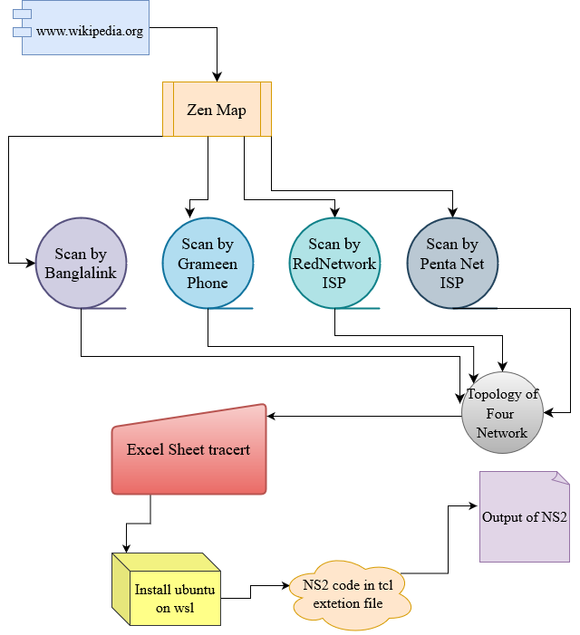
Bird’s eye view of the project
Find a website detailed information about IP address, protocols and services running on the network.
Name of selected website is www.wikipedia.org
Scan it by Zen map by four different networks.
Created an IP routing by excel sheet.
use NS2 for routing graphical interface.
Fig 1: Bird’s eye view of the project

Slide 5
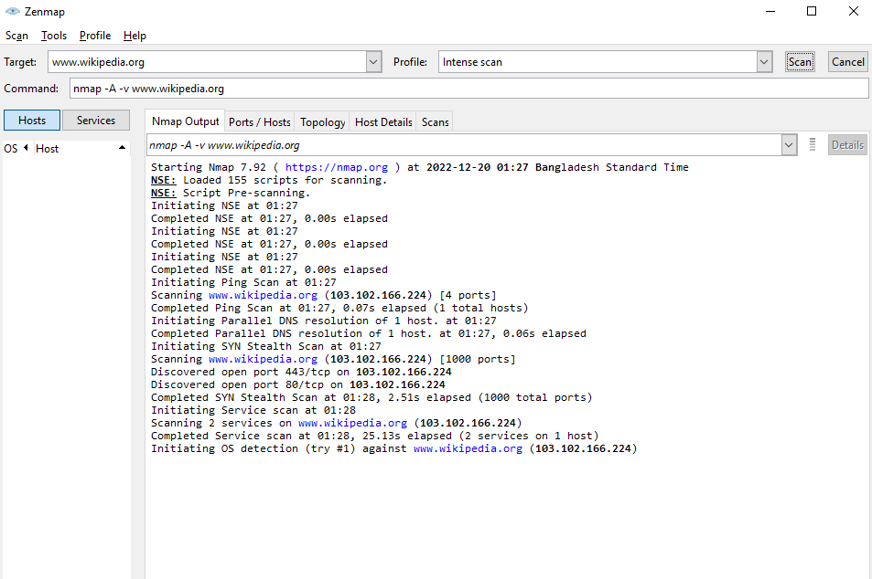
Zen Map
Zen Map is an open source network mapping tool that provides a graphical representation of network topology.
Used to analyse large networks in an efficient and time-saving manner.
Provides detailed information about the hosts, services, and networks that make up the network, including their geographic location. It also includes support for a variety of data sources such as Nmap scans, traceroutes, and SNMP information
With the help of Zen Map, users can easily identify security risks, identify network weaknesses, and plan network upgrades
Allows users to explore their networks in detail in order to identify potential security vulnerabilities and other problems
Fig 2: Zen Map interface

Slide 6
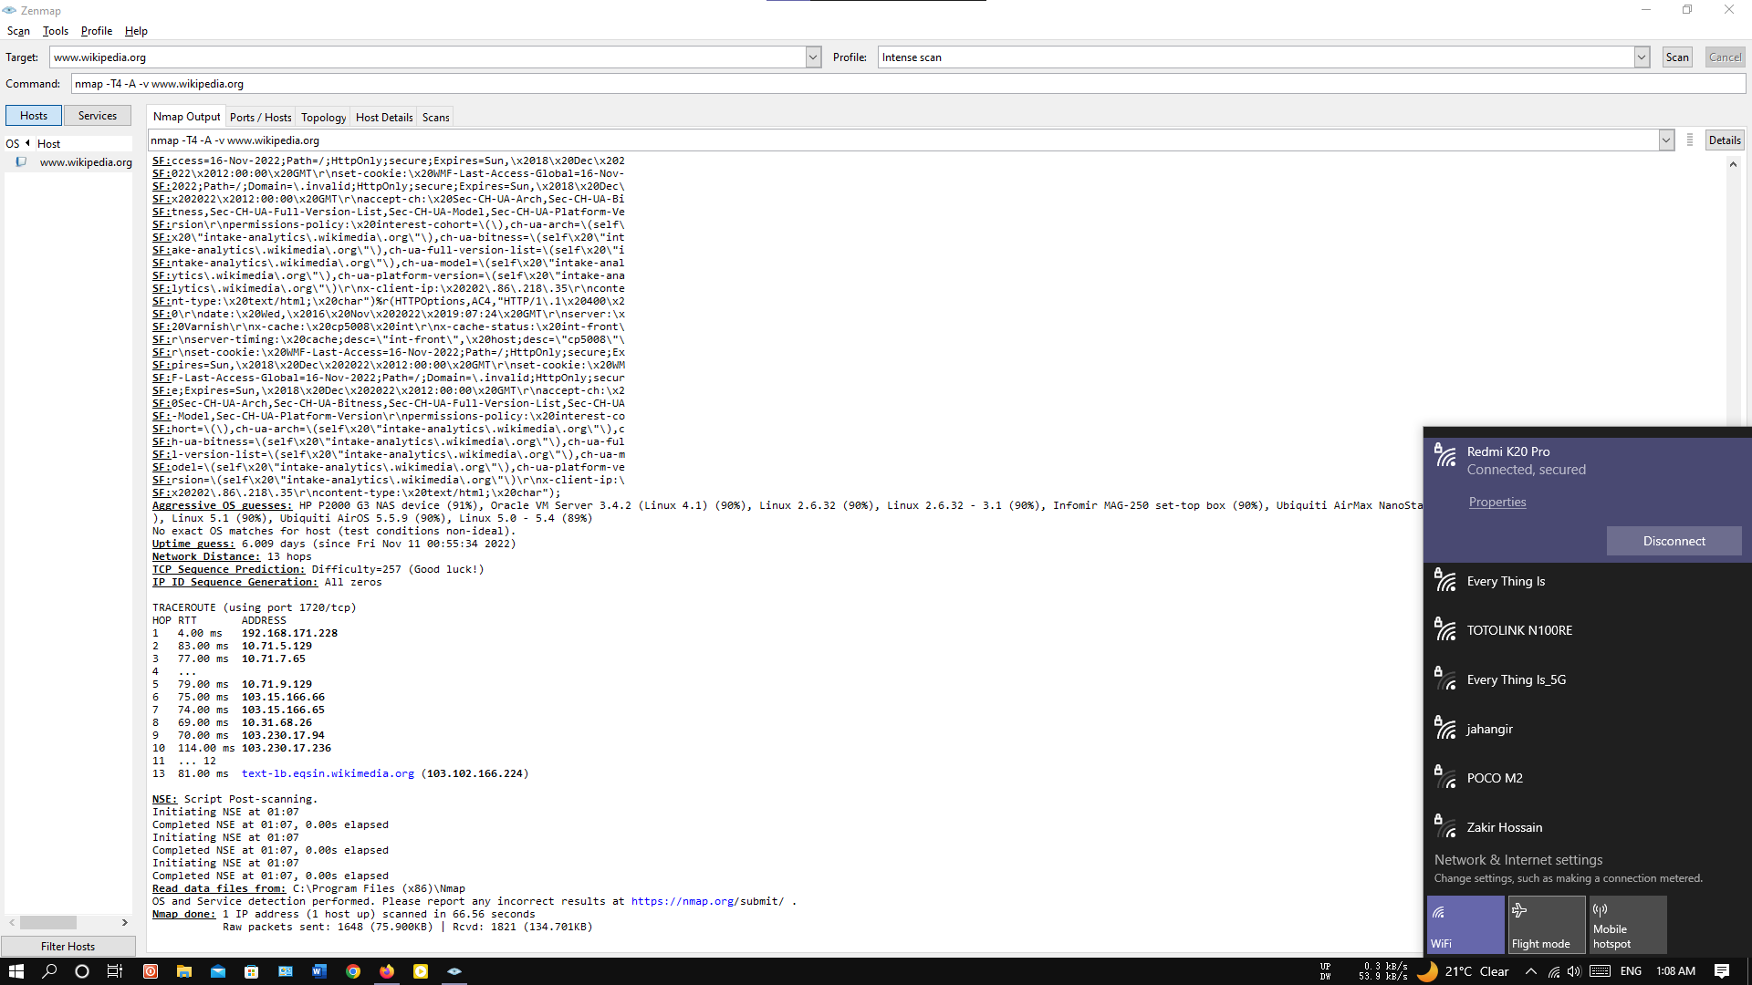
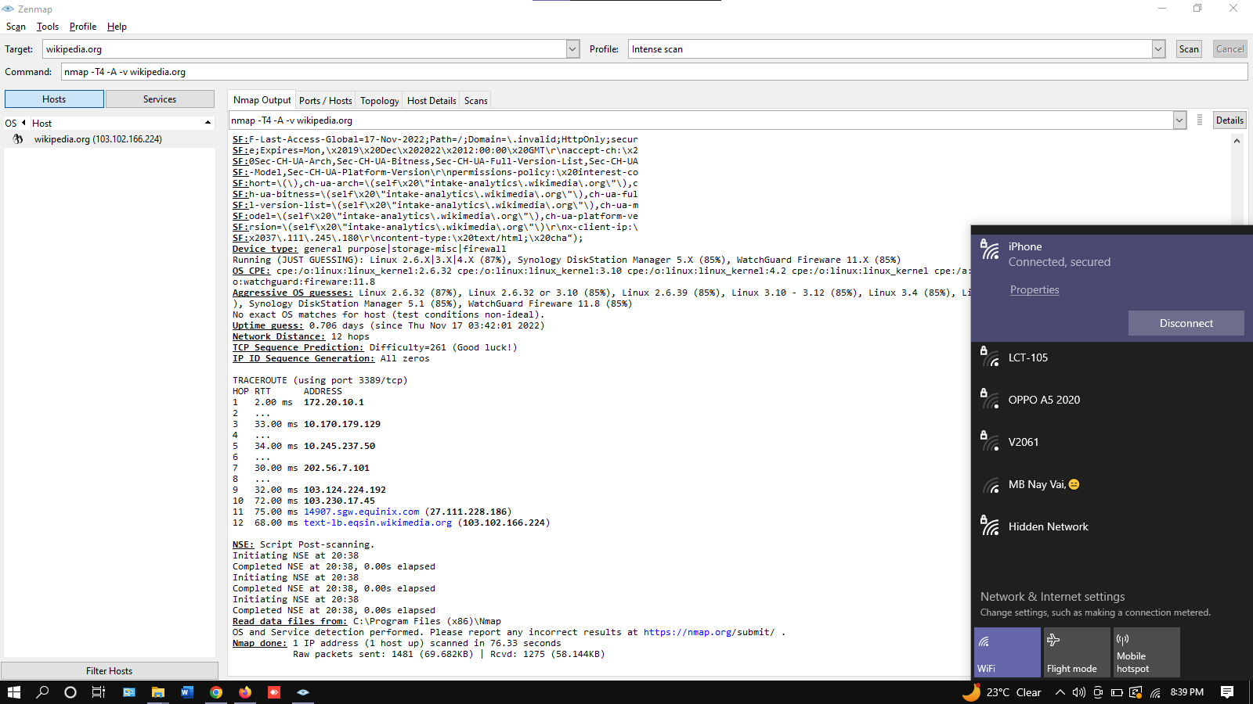
Different host to domain
Scan www.wikipedia.org by four different network and find the routing. We scan this website by two cellular network and two are WIFI network. Here we can see the four different network scan instance.
Fig 3 is the Banglalink cellular network output. In this scan output we can see that there are 11 different IP address from host to domain.
Fig 3: Banglalink network Zen map scan output
Fig 4 is the Grameen phone cellular network output. In this scan output we can see that there are 8 different IP address from host to domain.
Fig 4: Grameen phone network Zen map scan output

Slide 7
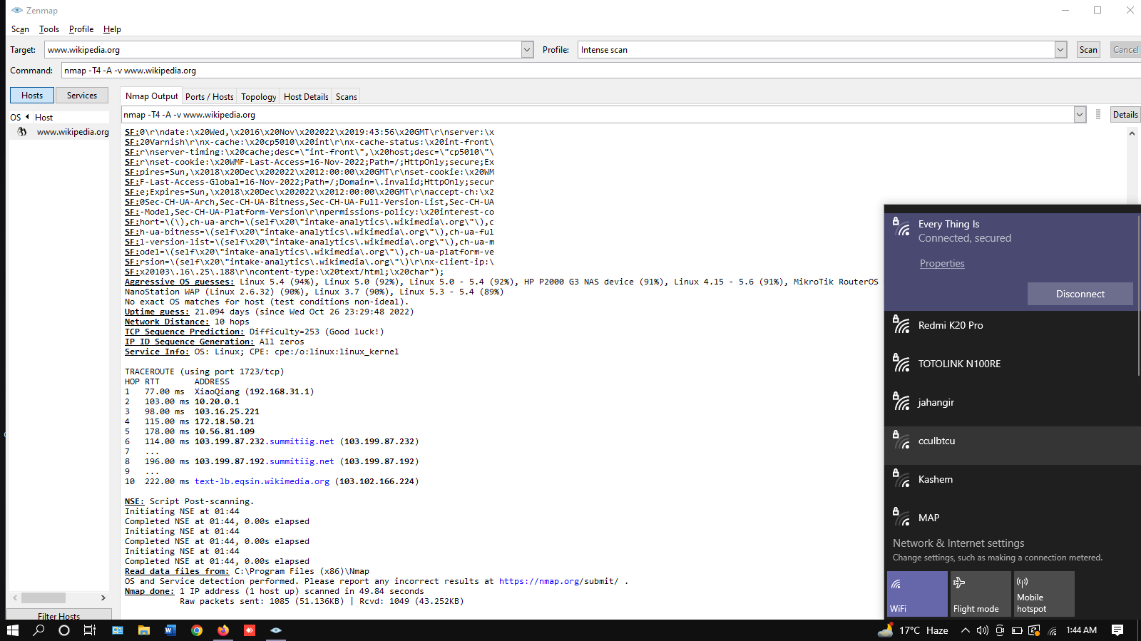
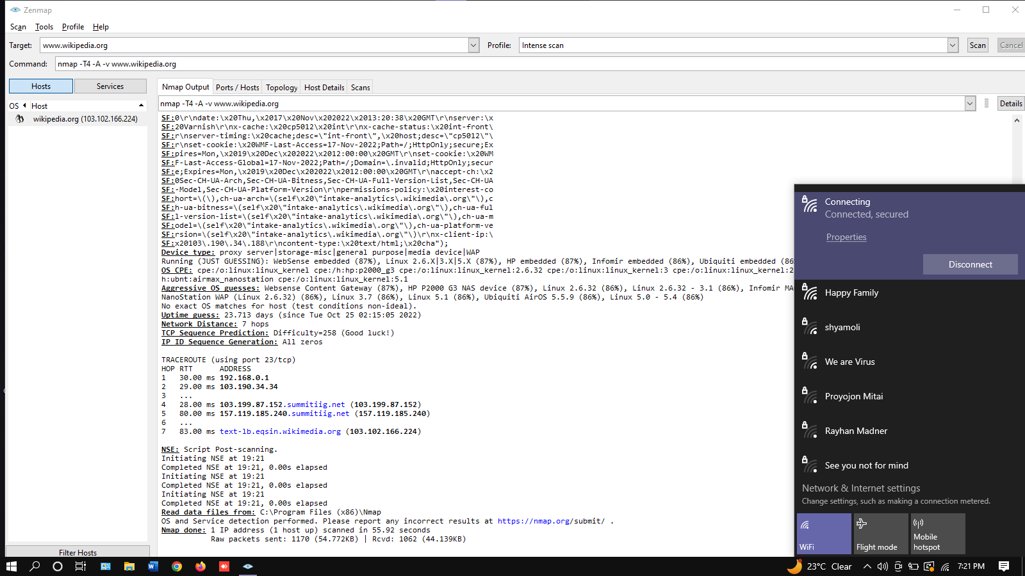
Fig 5 is the RednetNetwork ISP output. In this scan output we can see that there are 8 different IP address from host to domain.
Fig 5: RedNetwork ISP Zen map scan output
Fig 6 is the PentaNetwork ISP output. In this scan output we can see that there are 5 different IP address from host to domain.
Fig 6: PentaNetwork ISP Zen map scan output

Slide 8
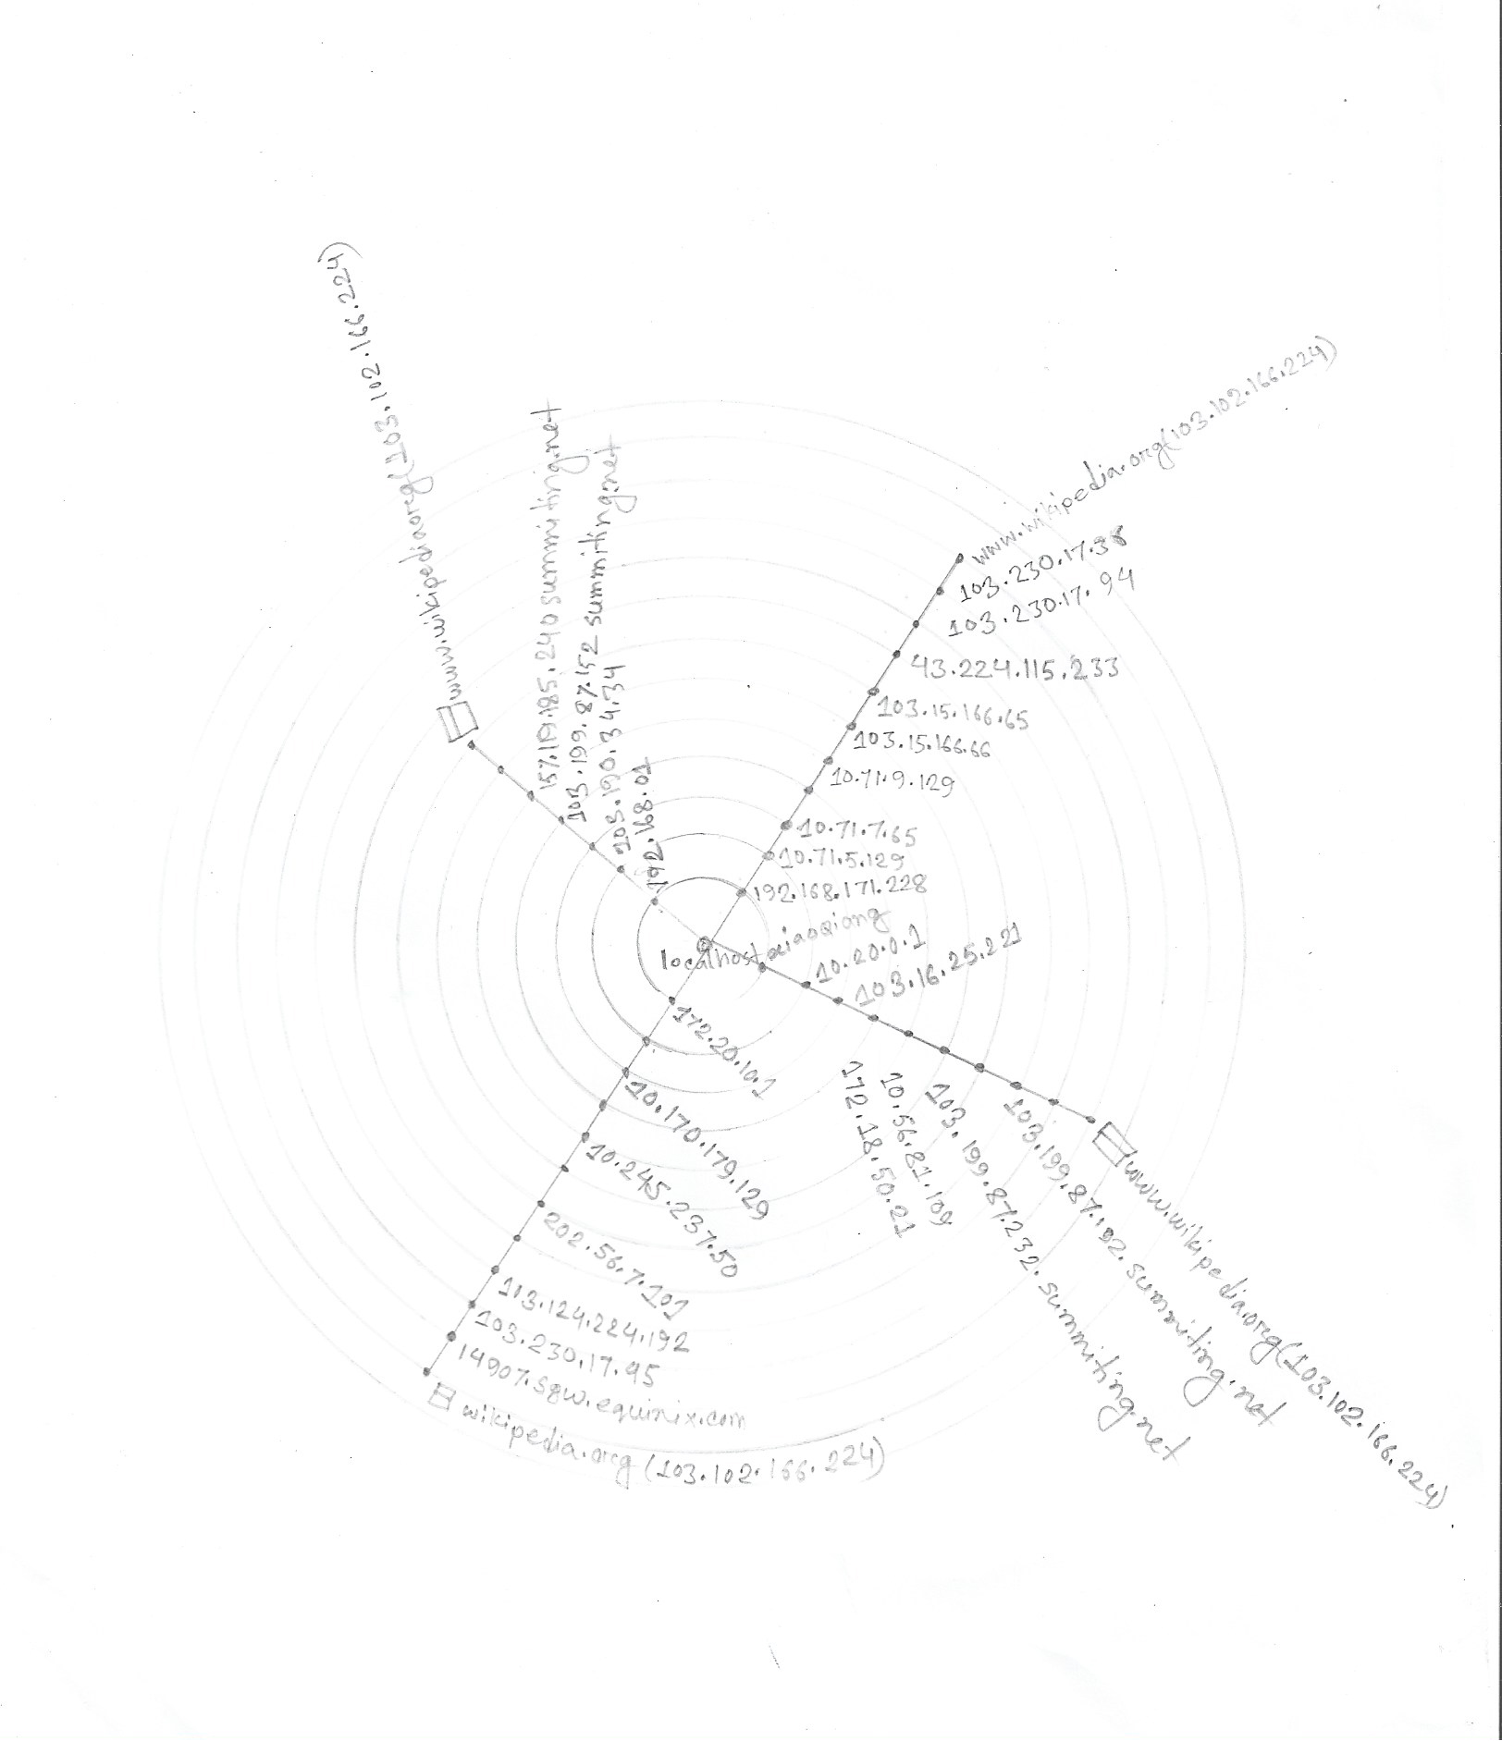
Design network topology
Network topology is the arrangement of computers, network devices and other components of a network.
Describes how various devices in a network are connected to one another and how they communicate.
Physical topology describes the physical layout of a network and the location of the various devices.
logical topology describes how data is transferred between the different nodes.
Fig 7: Network topology of Wikipedia

Slide 9
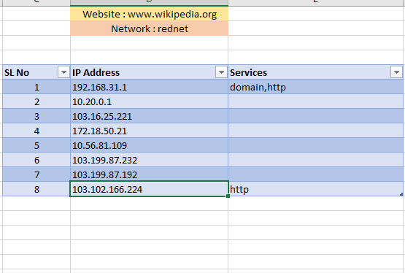
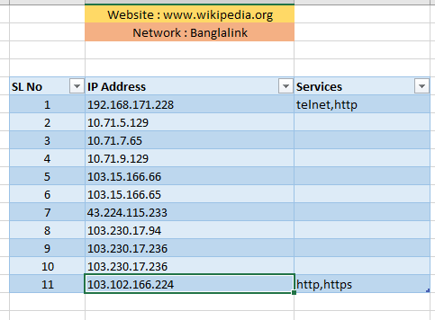
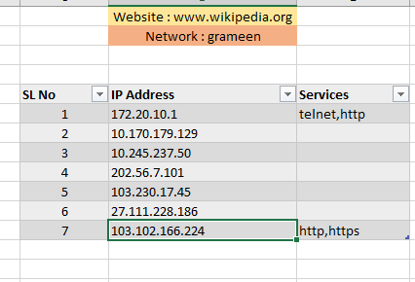
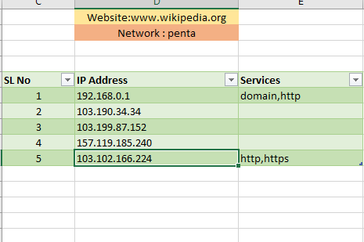
Excel sheet for network diagram
Creating network topology by Zen map now we ready a excel sheet for simulation.
First, we need to prepare four service table by serial by serial Ip address.
Then we need to put it into a another excel sheet by serial by serial.
Fig 10: Service table of RedNet ISP
Fig 8: Service table of Banglalink
Fig 9: Service table of Grameen phone
Fig 11: Service table of Penta ISP

Slide 10
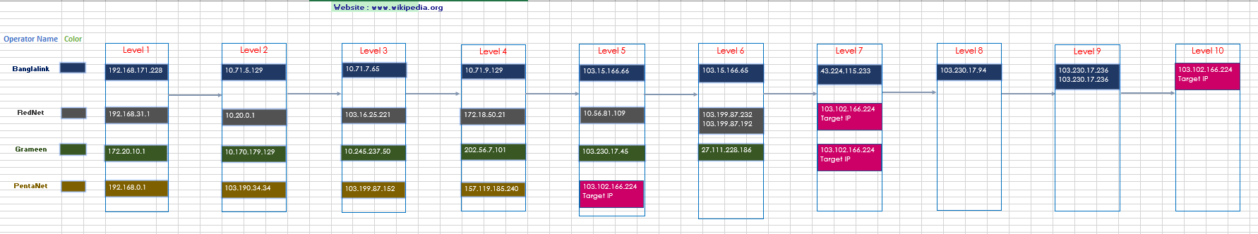


Four different networks goes to target address by many different Ip address.
Create a excel tracert for visualize the simulation process.
Fig 12: Full excel sheet tracert

Slide 11
Network Simulator 2 (NS2)
Network Simulator 2 (NS2) is a powerful and widely used open source discrete event network simulator.
Used in academic and research institutions as well as in industry for simulation and modelling of computer networks, communication networks, and other distributed systems.
Network simulator 2 is a Linux based software.
NS2 is capable of simulating wired, wireless and mobile networks, and offers a wide range of features, including routing protocols, traffic models, and an extensive library of simulation scripts.
Provides an extensible and easy-to-use programming interface for experimentation and development.
NS2 is an ideal platform for network design, evaluation, and exploration.

Slide 12
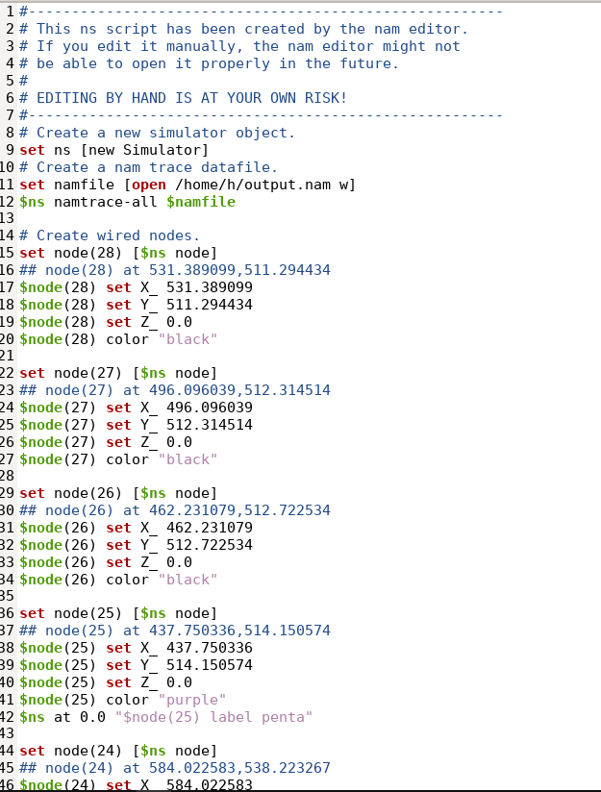
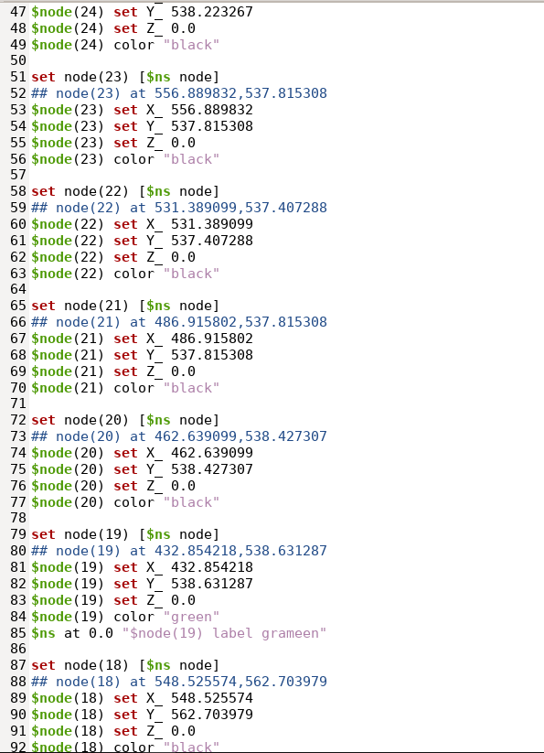
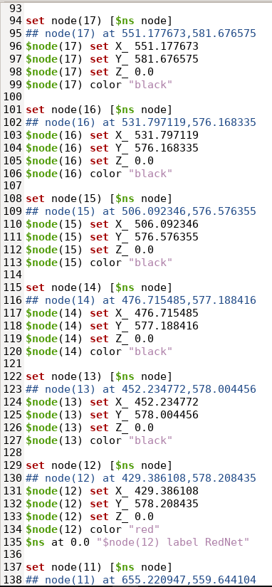
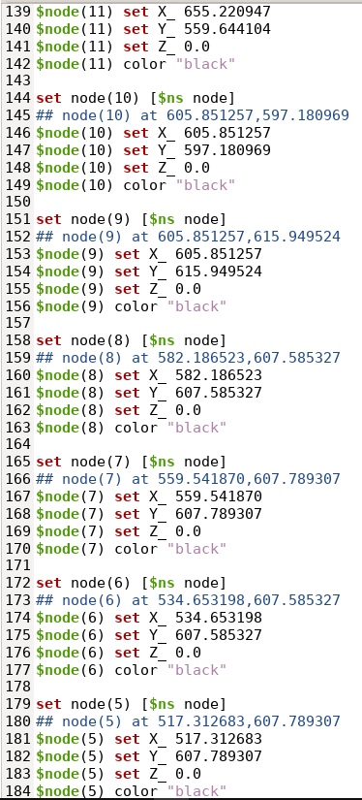
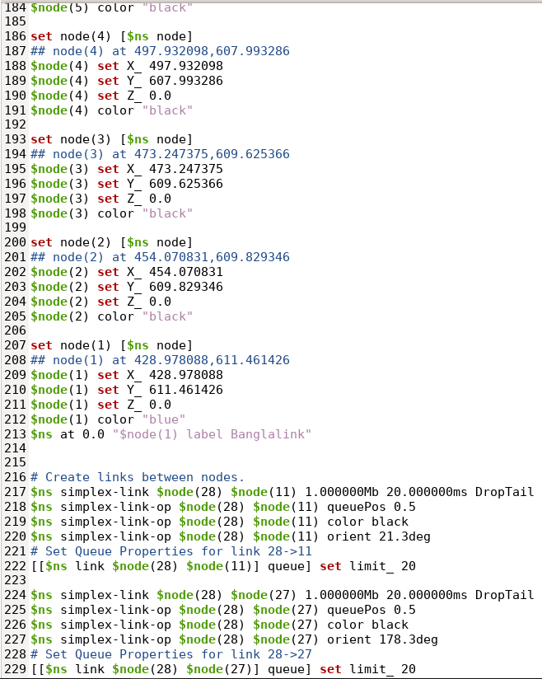
Source code of NS2
The source code of NS2 are edit and store in TCL extension file.

Slide 13
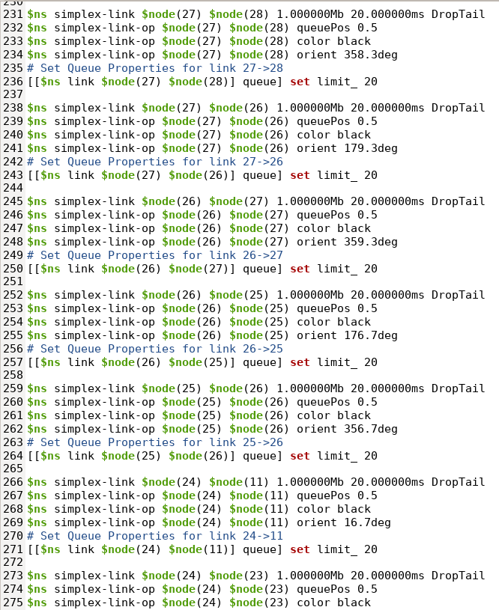
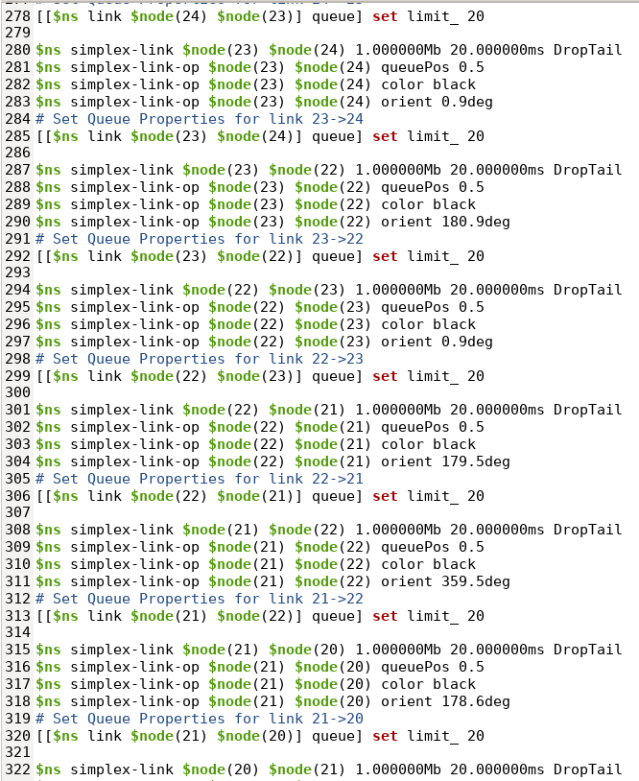
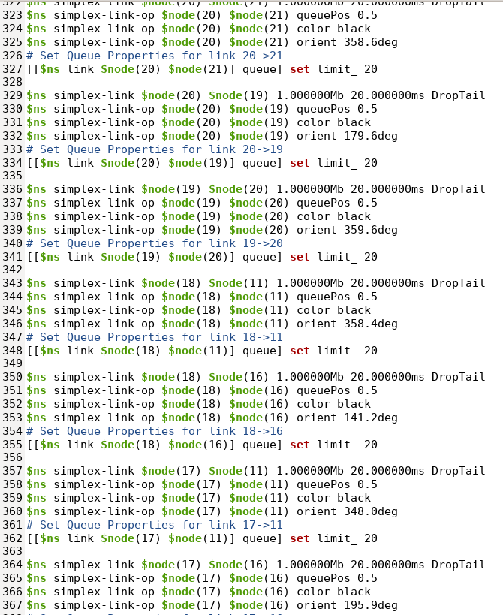
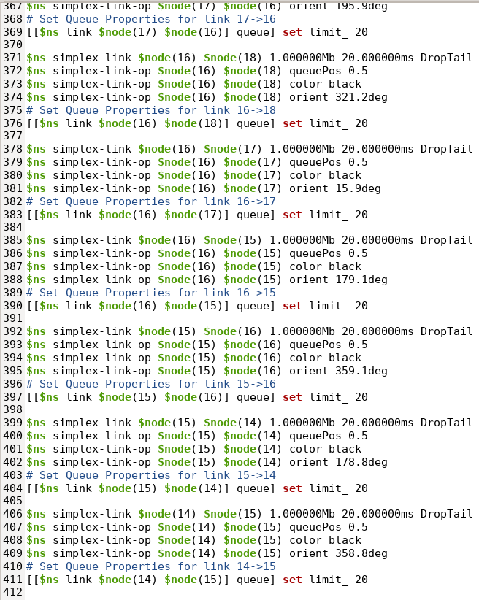
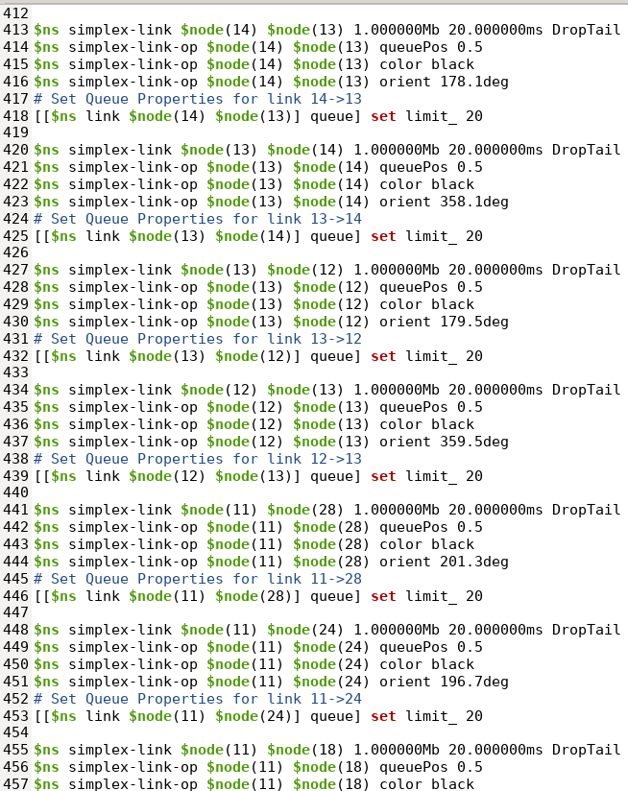
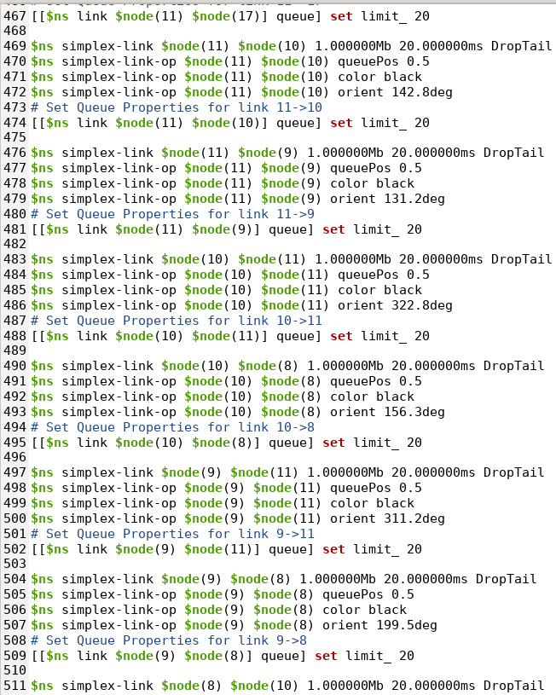
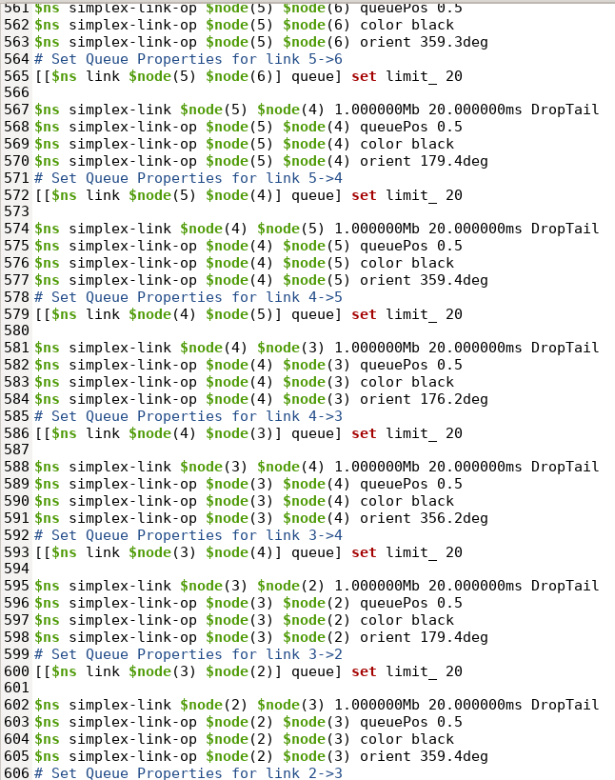
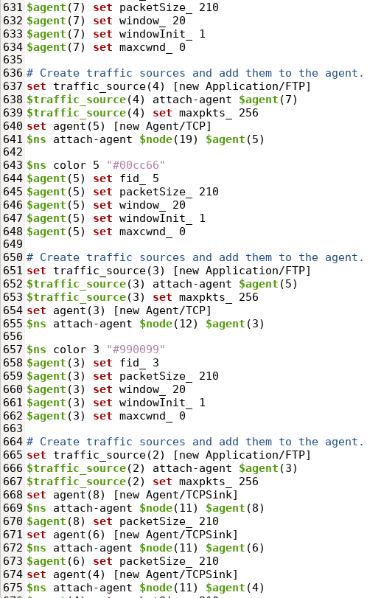
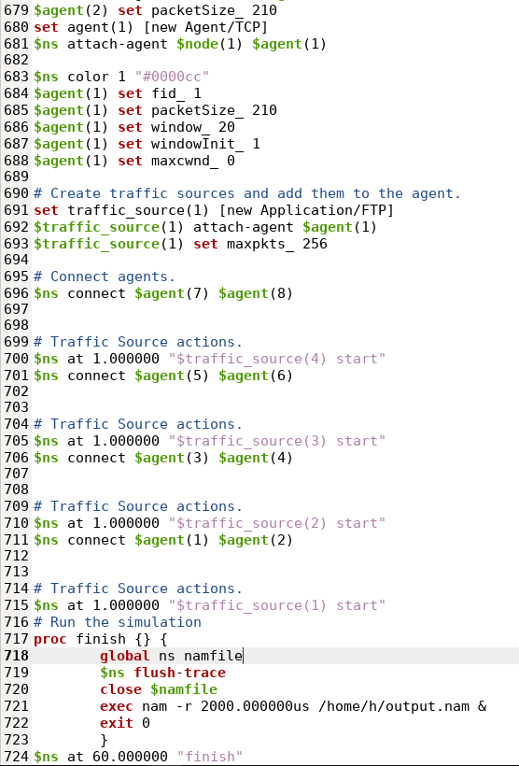

Slide 14
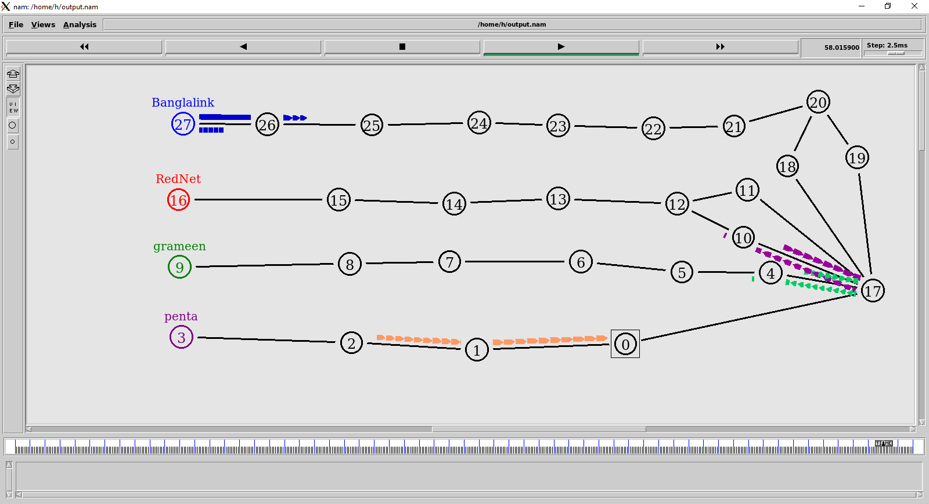
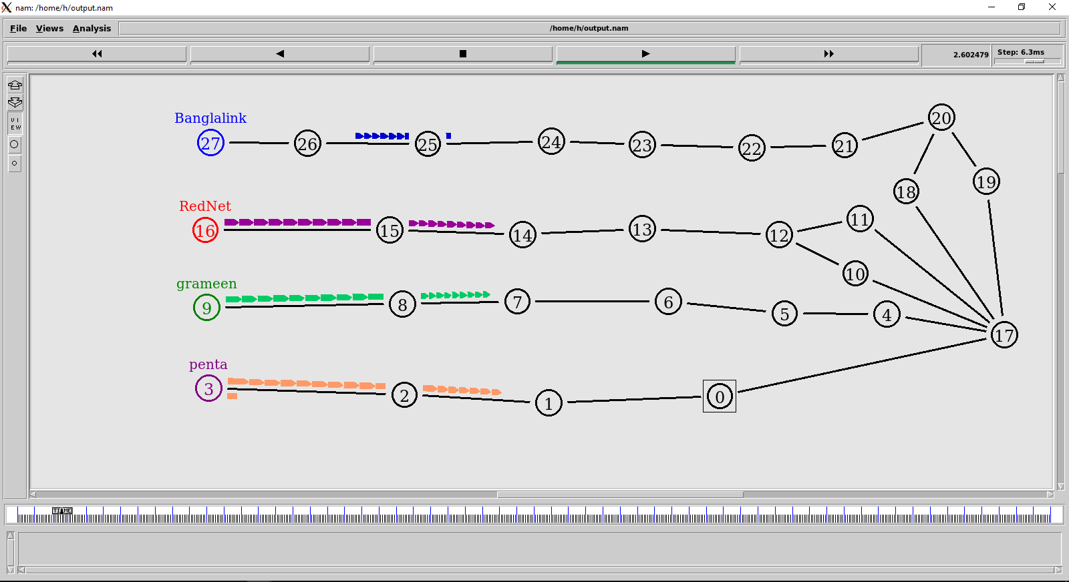
Output topology of NS2
After completing the coding into TCL file then running the code then this graphical inter face will be shown.
Fig 14: Third output of NS2
Fig 13 is the starting position of the NS2. Here we can see that the data packet is very small and they are started to going to the target point. The data packet is going serially by one by one.
Fig 14 is the last position of the ns2. In this position we can see that the data packets are going to the target point but the data packets are very smaller and they are return into starting point.
Fig 13: Fast output of NS2

Slide 15
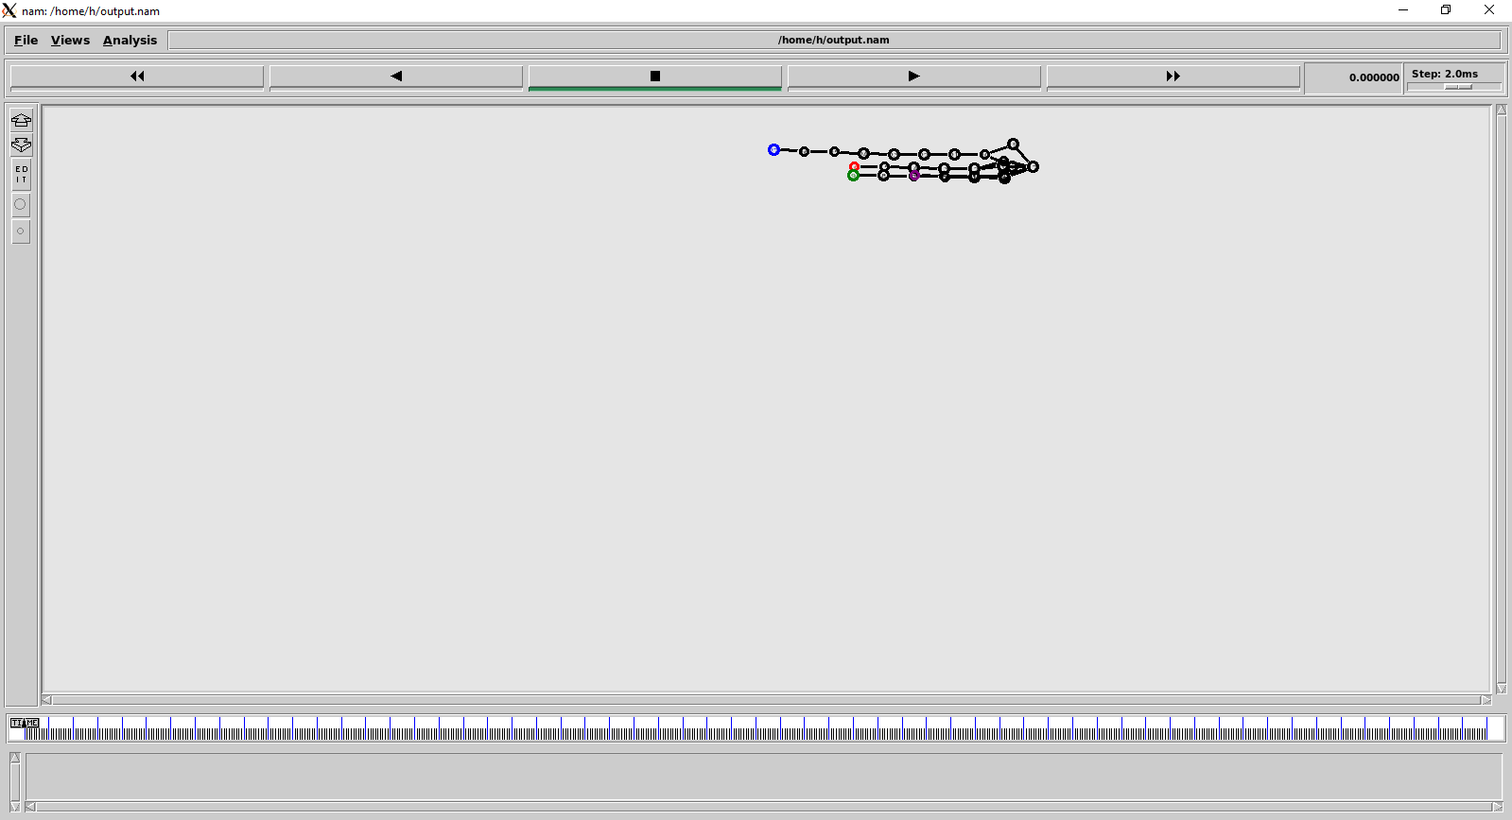
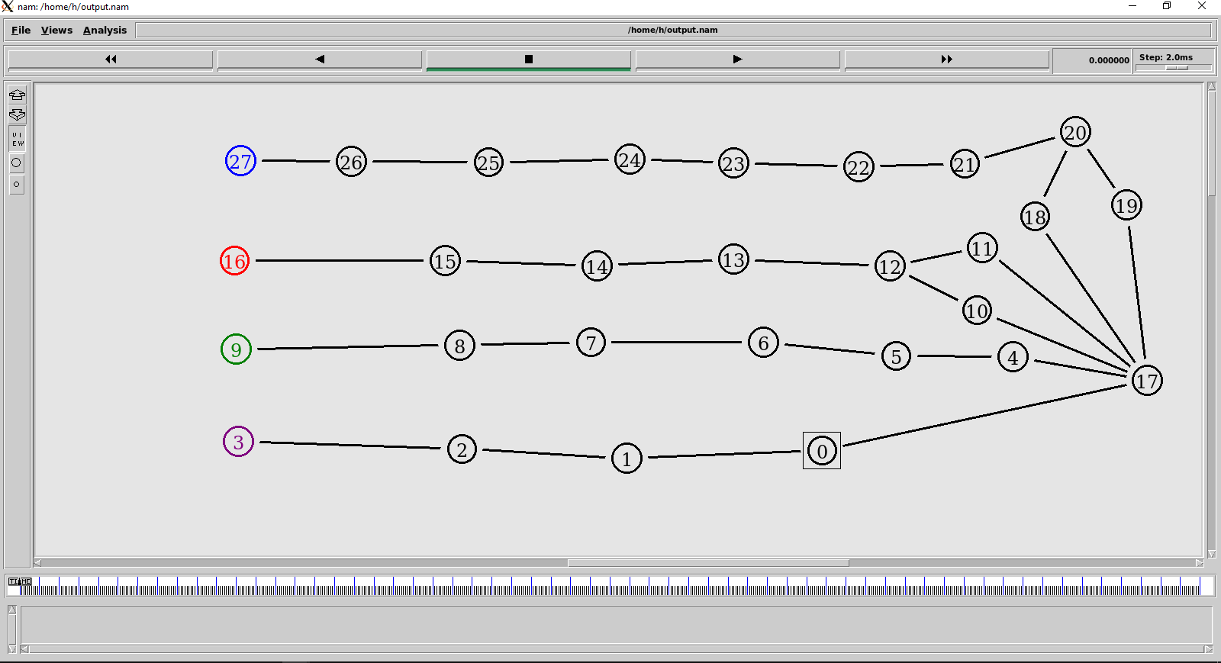
Summarization of the designed network
When we run the code of NS2 its look like this. But it not clear and not visible. For a clear visibility we need to re-position the node.
Fig 19 we see that node are not visible. For visualizing this first we need to zoom in the size of the node then need to be press the edit button then the node is can be move able and clear
Fig 20 is the clear view of the output. After editing the node these is the view of output.
Fig 15: After Run the code
Fig 16: After Resurrection the node

Slide 16
Conclusion
The network lab was a great learning experience for everyone involved.
Able to gain a better understanding of networking concepts and how to apply them in different scenarios.
Learned about different tools and techniques used to troubleshoot and configure networks
Zen map and Network Simulator 2 are powerful tools for network administrators to use in order to test and troubleshoot network configurations.
Zen map provides a graphical user interface for network scanning and security auditing, while Network Simulator 2 allows users to model and simulate networks for testing purposes.
Both tools are easy to use and can help administrators to quickly identify and resolve network issues.
Both tools are free and open source, making them accessible to a wide range of users.
With the knowledge gained from this lab, we can now more confidently configure, maintain, and troubleshoot networks.

Slide 17

Thank you

